Slide 1






Vrinda Store Sales Analysis
Business Data Analysis Project using MS Excel
Presented By:
ADITI KUMARI

Slide 2



Executive Summary
Total Revenue: ₹21.17 million, with Ajio as a key contributing channel
Customer Insight: Women drive 64% of total sales, outperforming men
Top Markets: Maharashtra, Karnataka, and Uttar Pradesh lead in sales contribution
Age Group Trend: Adults (25–60 years) place the highest number of orders, with Adult Women being the largest customer segment
Key Takeaway: Vrinda Store’s growth is primarily driven by adult women customers in high-performing states, highlighting a clear opportunity for focused, data-driven marketing strategies.

Slide 3




Business Problem Statement
Vrinda Store wants to understand:
Sales and order trends over time
Customer demographics (gender, age, state)
Performance of sales channels
Factors driving maximum revenue
The goal is to identify improvement areas and increase sales in 2023.

Slide 4


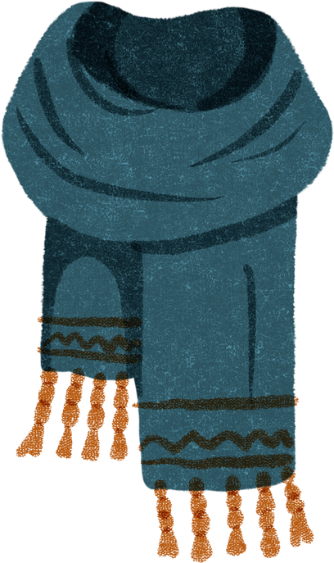

DATA OVERVIEW & METHODOLOGY
The analysis is based on Vrinda Store’s 2022 sales dataset, which captures detailed information on customer orders and sales performance.
The dataset includes key attributes such as order date, sales value, order status, gender, age group, state, sales channel, and product category.
To analyze the data effectively, Microsoft Excel was used as the primary tool.
Pivot Tables and Pivot Charts were created to summarize large volumes of data and identify patterns.
Interactive slicers and dashboards were used to enable dynamic filtering and comparative analysis across different dimensions.
Purpose: This structured approach helps transform raw sales data into meaningful insights, supporting data-driven decision-making and business strategy formulation.

Slide 5

Revenue & Geographic Performance
Objective : To assess revenue contribution by gender and identify top-performing states.
Revenue by Gender
Women: ₹13.56M (64%)
Men: ₹7.61M (36%)
Total Revenue: ₹21.17M
Insight:
Women generate nearly 2× the revenue of men, indicating a strong women-focused product demand.
Top 5 States by Revenue
Maharashtra: ₹2.99M
Karnataka: ₹2.65M
Uttar Pradesh: ₹2.10M
Telangana: ₹1.71M
Tamil Nadu: ₹1.68M
Insight: Sales are concentrated in West & South India, with Maharashtra contributing ~14% of total revenue.

Slide 6
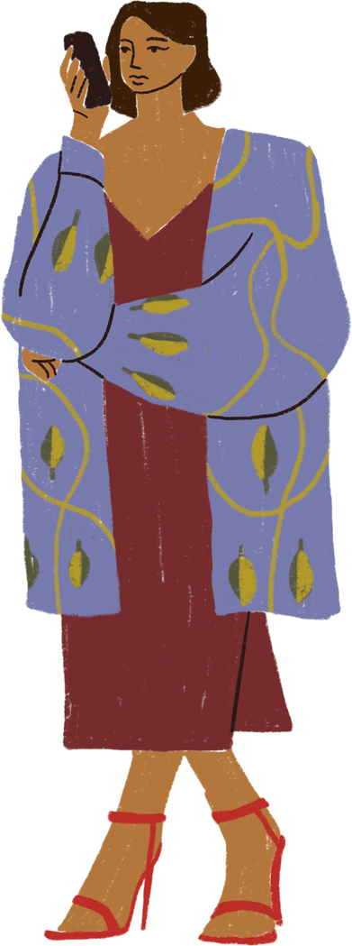
Customer Demographics & Operational Insights Objective
Order Distribution by Age & Gender
Adult Women: 34.6% (largest customer segment)
Teenage Women: 21.1% (strong secondary segment)
Adult Men: 15.5%
Senior (Men + Women): ~20% (lower contribution)
Insight:
Adult Women form the core customer persona, while Teenage Women represent a fast-growing, trend-driven segment.
Category & Operations Analysis
Top Categories: Kurtas, Sets, Western Dresses, Tops
Order Status: Majority Delivered; some Returns & Cancellations observed
Size Trend: High demand for XL, XXL, 3XL, 4XL across categories
Insight:
Strong plus-size demand → inventory planning opportunity
Returns in select categories (e.g., Men’s Western wear) indicate a need for fit/quality review

Slide 7


Strategic Recommendations
Action Plan for Stakeholders:
Inventory Optimization:
Increase stock depth for Women’s Kurtas and Sets.
Ensure Plus-Size (XXL, 3XL) availability is high, as demand is visible across age groups.
Marketing Focus:
Target Audience: Adult Women (25-50 yrs).
Geo-Targeting: Run hyper-local campaigns in Maharashtra, Karnataka, and UP.
Channel: Since this data is for "Ajio," consider replicating best-selling SKUs on other channels (Amazon, Flipkart) or the Vrinda Store website.
Logistics & Operations:
Investigate the return rate for specific categories (like Men's Western Wear) to improve product descriptions or size charts, potentially reducing return logistics costs.

Slide 8

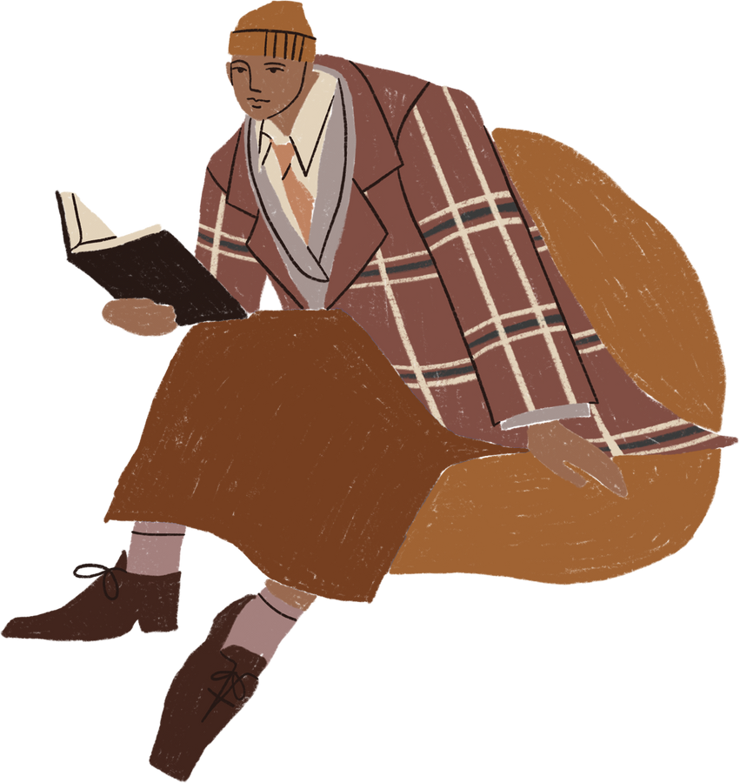


Summary:
Vrinda Store has a clearly defined market position with a strong female-centric customer base, particularly in the Adult and Teenager demographics. The business is geographically concentrated in the West and South of India.
Final Takeaway:
To scale further, Vrinda Store should double down on its winning categories (Women’s Ethnic/ fusion wear) while optimizing supply chain logistics for its top states (MH, KA) and exploring untapped potential in the North and East.
Conclusion

Slide 9




THANK YOU

